Slide 1



Global Wheat Trade and Price Dynamics: A 30-Year Analysis of Trends, Shocks, and Shifts
By: Azmath Noorain
Date: April, 29,2025

Slide 2
CONTENTS
1. Target Audience
6. Rising Action - Cracks in the System
2. Welcome & Agenda
7. Climax - The 2022 Wheat Crisis
3. The Big Picture – Global Trends
8. Falling Action - New Strategies
4. Life Cycle of Data Visualizations
9. Conclusion - A New Era of Wheat
5. An Ordered World (Plot)
10. Dual Axis Analysis

Slide 3


01. Target Audience
Mr. Carlos Mendes, Head of Supply Chain Risk at a global grain trader
Oversees procurement, logistics, and risk mitigation for one of the world’s largest privately held grain trading firms.
Addressed Question: “With shocks looming from climate, conflict, and policy, how can we build a resilient wheat supply chain that keeps customers supplied without breaking the bank?”*
Other Stakeholders
1
Global Trade Analysts
2
Agricultural Economists
3
Policy Makers
4
Food Security Experts
*Source: Google, LinkedIn

Slide 4

02
Welcome & Agenda
Why wheat matters globally
What we’ll cover: Trends, shocks, adaptations, and a holistic view

Slide 5

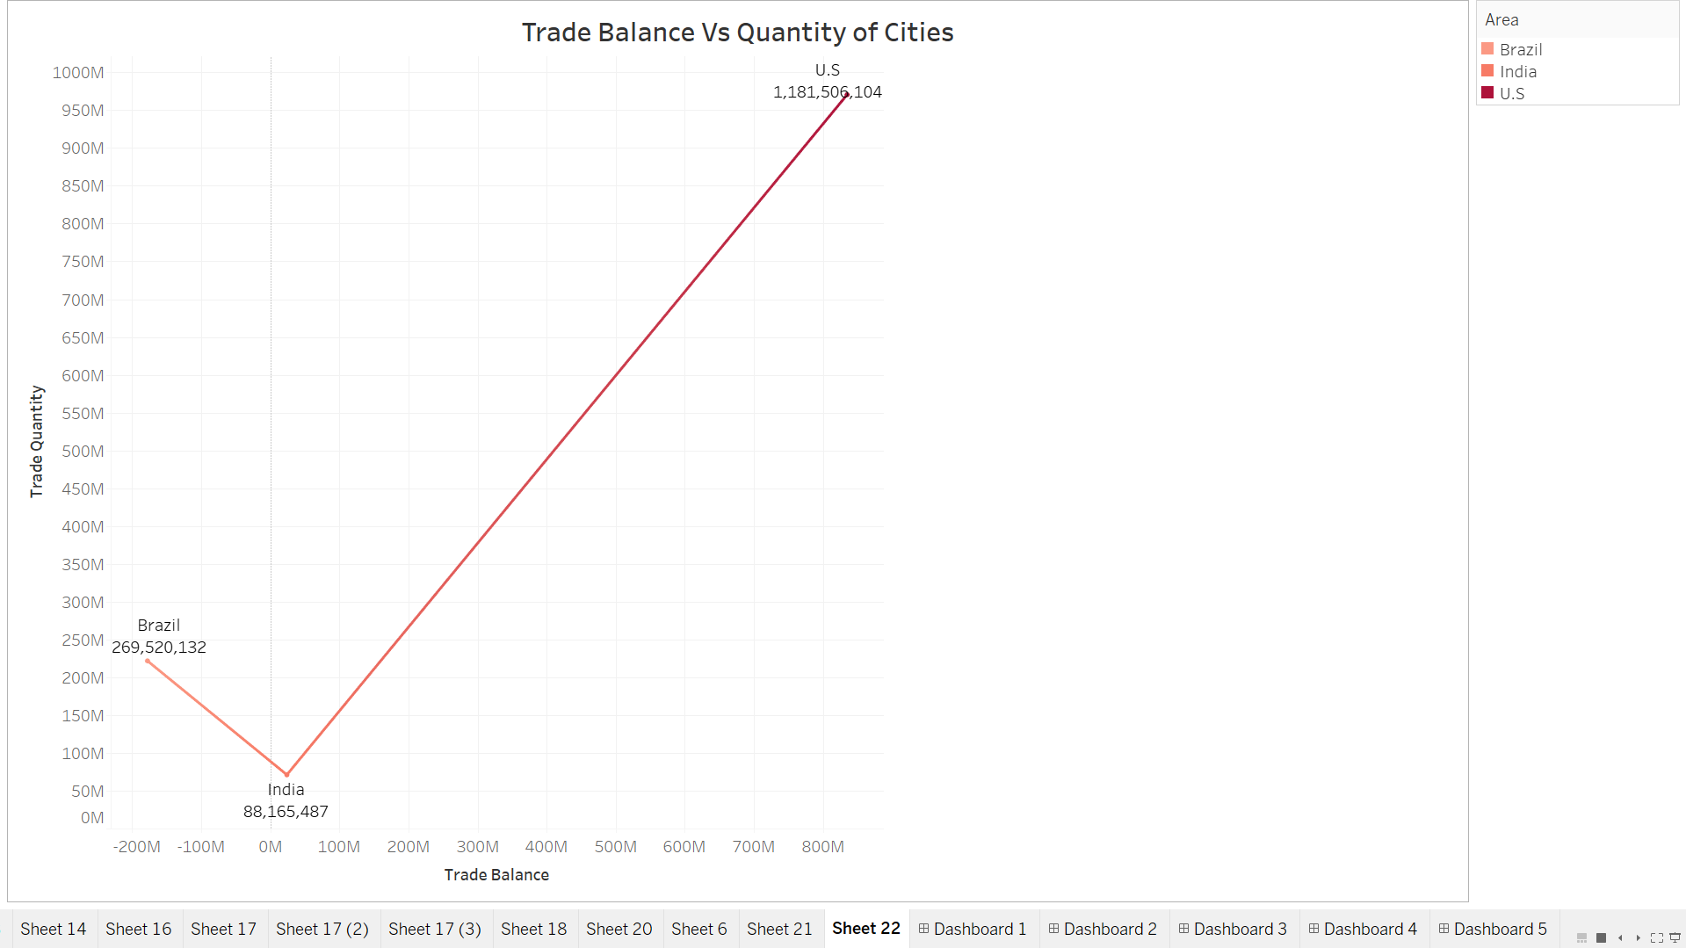
03
The Big Picture – Global Trends

Slide 6


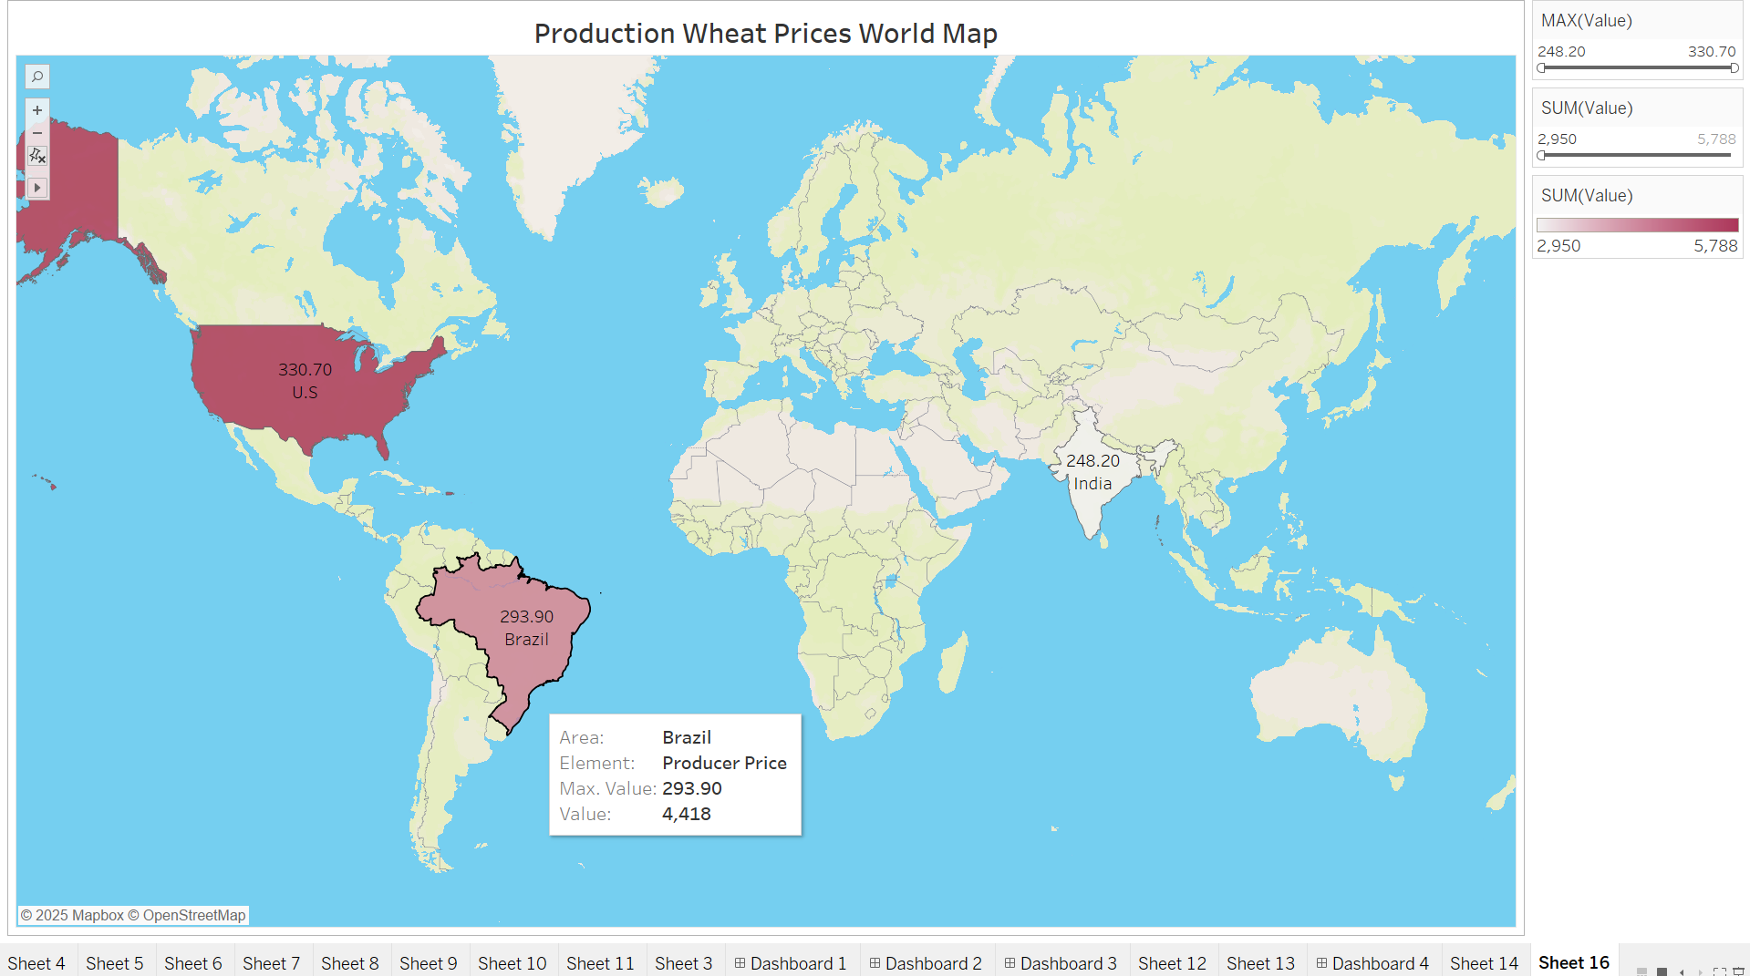

The Big Picture – Global Trends
U.S. as a dominant exporter.
India as a growing player.
Brazil as a developing importer-turned-producer.

Slide 7





04. Life Cycle of Data Visualization
Data Cleaning: Ensuring accuracy and consistency in trade volume and pricing datasets using Tableau Prep.
Data Collection: Gathering datasets from reliable source FAOSTAT.
2
1
3
Analysis: Identifying trends and inconsistencies in wheat trade values and volumes.
5
Presentation: Compiling insights into a coherent PowerPoint format for effective communication.
4
Visualization: Creating impactful charts and graphs to represent the finding using Tableau.

Slide 8

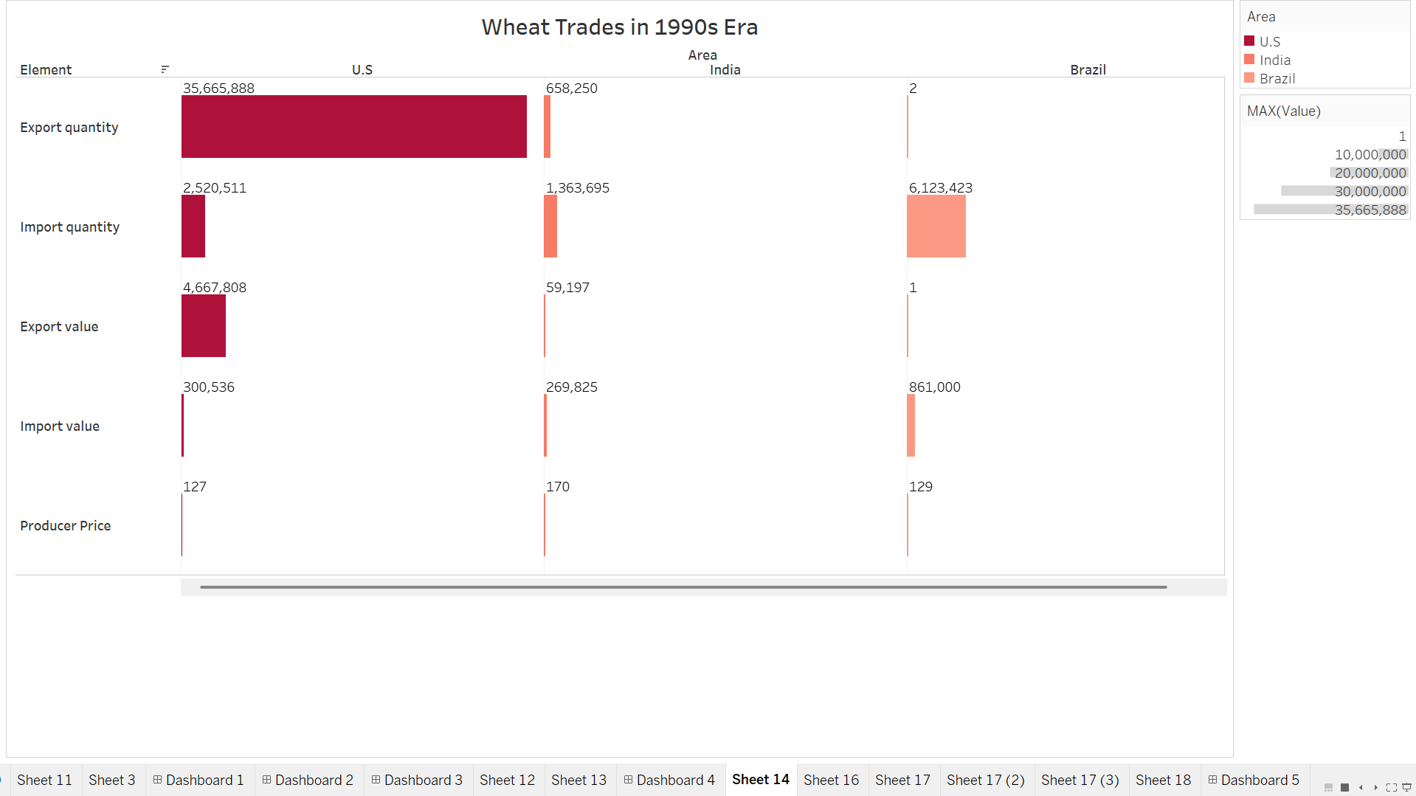

05
An Ordered World (Plot)

Slide 9


Summary of the Era 1990s
1
The U.S. dominated wheat exports, saturating the market with its production.
2
India, with its capacity challenges, remained heavily reliant on imports.
3
Brazil was largely an observer in the exports realm, mostly dependent on other nations for wheat.

Slide 10

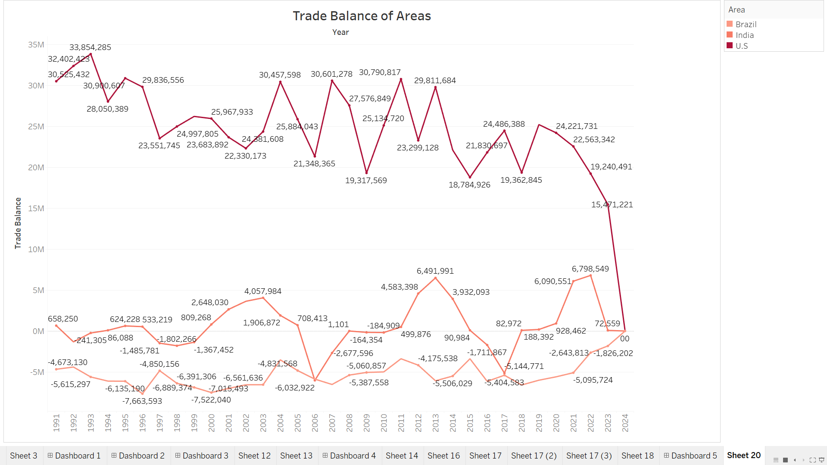
06
Rising Action - Cracks in the System

Slide 11

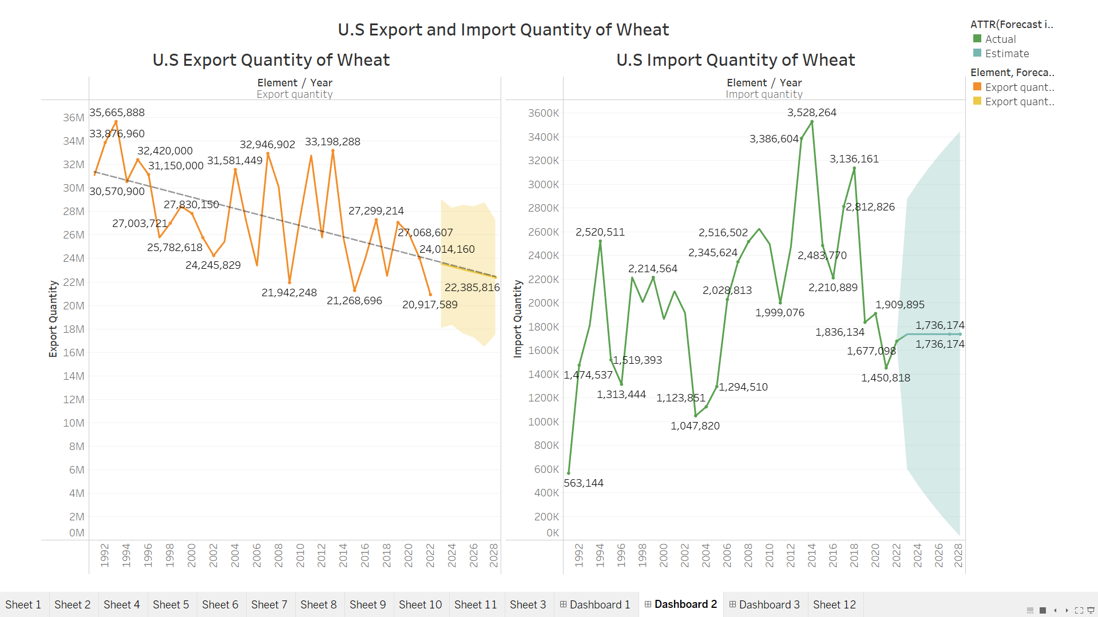
America’s Wheat Story
Exports peaked in 1992.
Drought year in Midwest:2012 -> steady decline -> imports increase.
Imports remain low -> U.S.'s self-sufficiency, but are slowly rising.

Slide 12

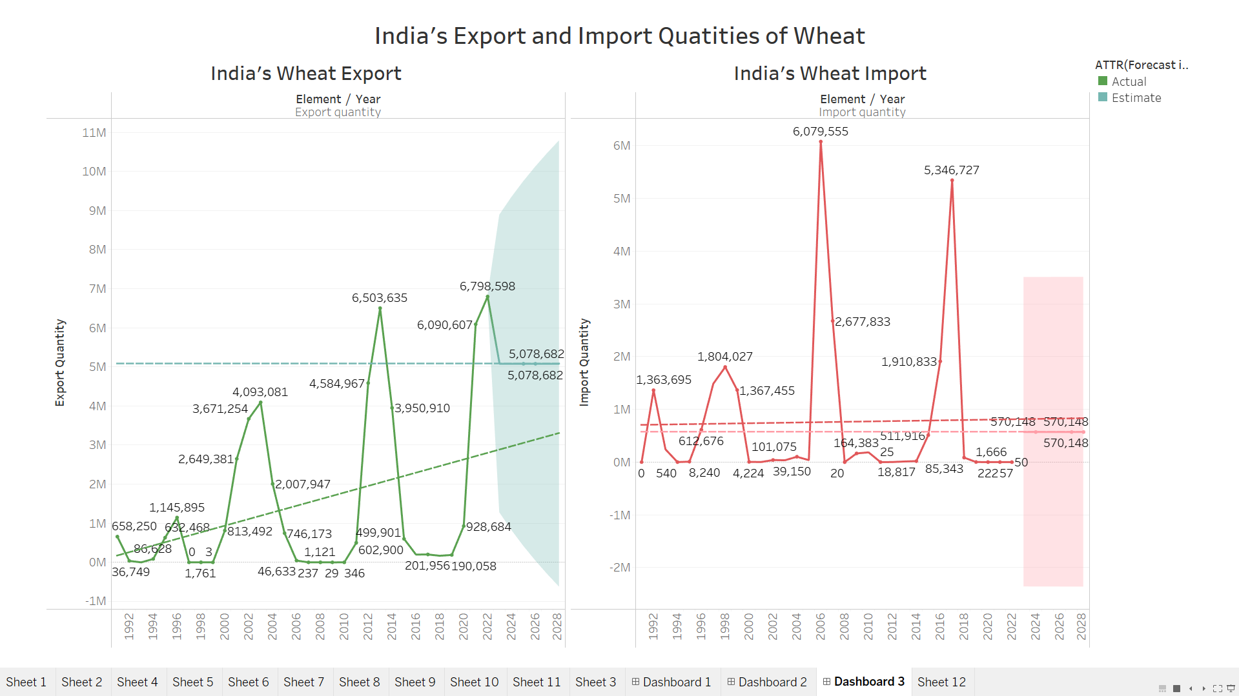
India’s Emergence on the World Stage
Bad Harvest and domestic needs (2006) -> increased Imports.
Exports peaked in 2012 -> bumper harvests.
Deficient rainfall in the 2015 monsoon season -> Peaked Imports 2016
2022 export ban Policy -> Heat Waves

Slide 13

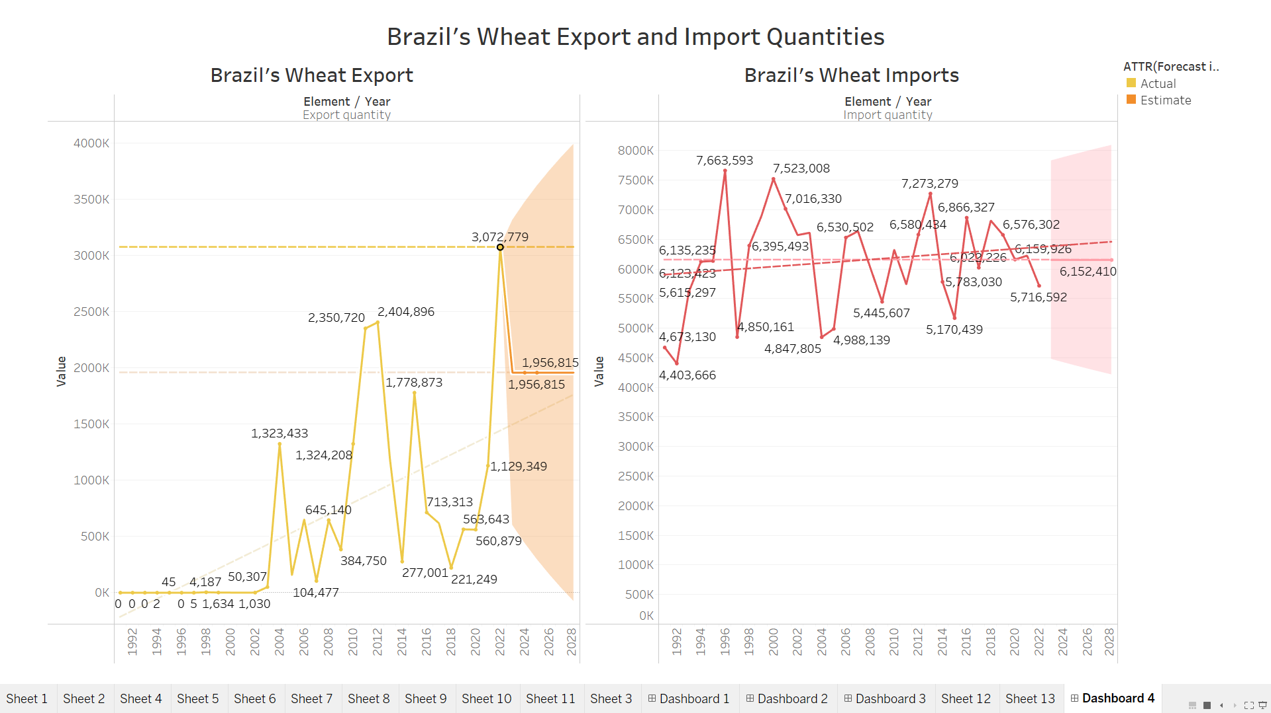
Brazil’s
Growing
Ambitions
Poor harvest years (e.g., 1996, 2002, 2013)
2018 -> Drought Shock; 2022 -> best year Harvest
2024 -> floods and fires destroyed crops

Slide 14




Challenges Arise
U.S. wheat exports fluctuated due to emerging competitors like Russia, Ukraine, and Australia.
India implemented agricultural reforms, leading to improved wheat production.
1
2
4
3
Climate change and trade disruptions introduced further stress to the wheat supply chain.
Brazil invested in tropical wheat research, shifting from an importer to an emerging producer.

Slide 15
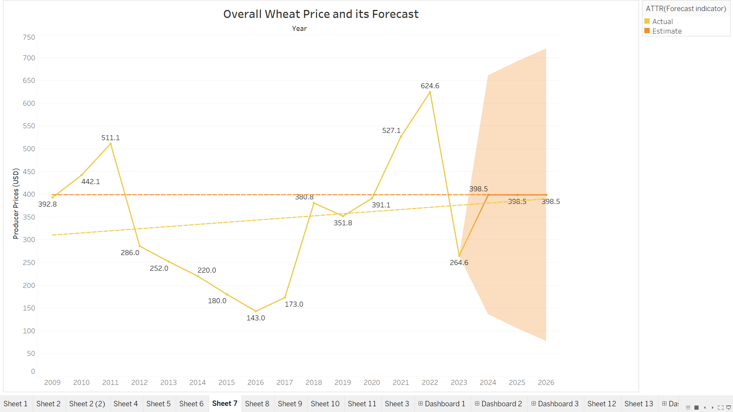
07
Climax - The 2022 Wheat Crisis

Slide 16




Critical Turning Point: When Prices Go Wild
The Russia-Ukraine war caused significant halts to wheat exports, accounting for nearly 30% of global supply disruptions.
Global wheat prices soared due to rising demand and limited supply.
1
2
The U.S. faced difficulty meeting this demand, while India had to impose a temporary export ban following a severe heatwave.
Brazil's importance began to rise as a reliable wheat producer in a time of global instability.
4
3
*Information is taken from news and recent happenings

Slide 17
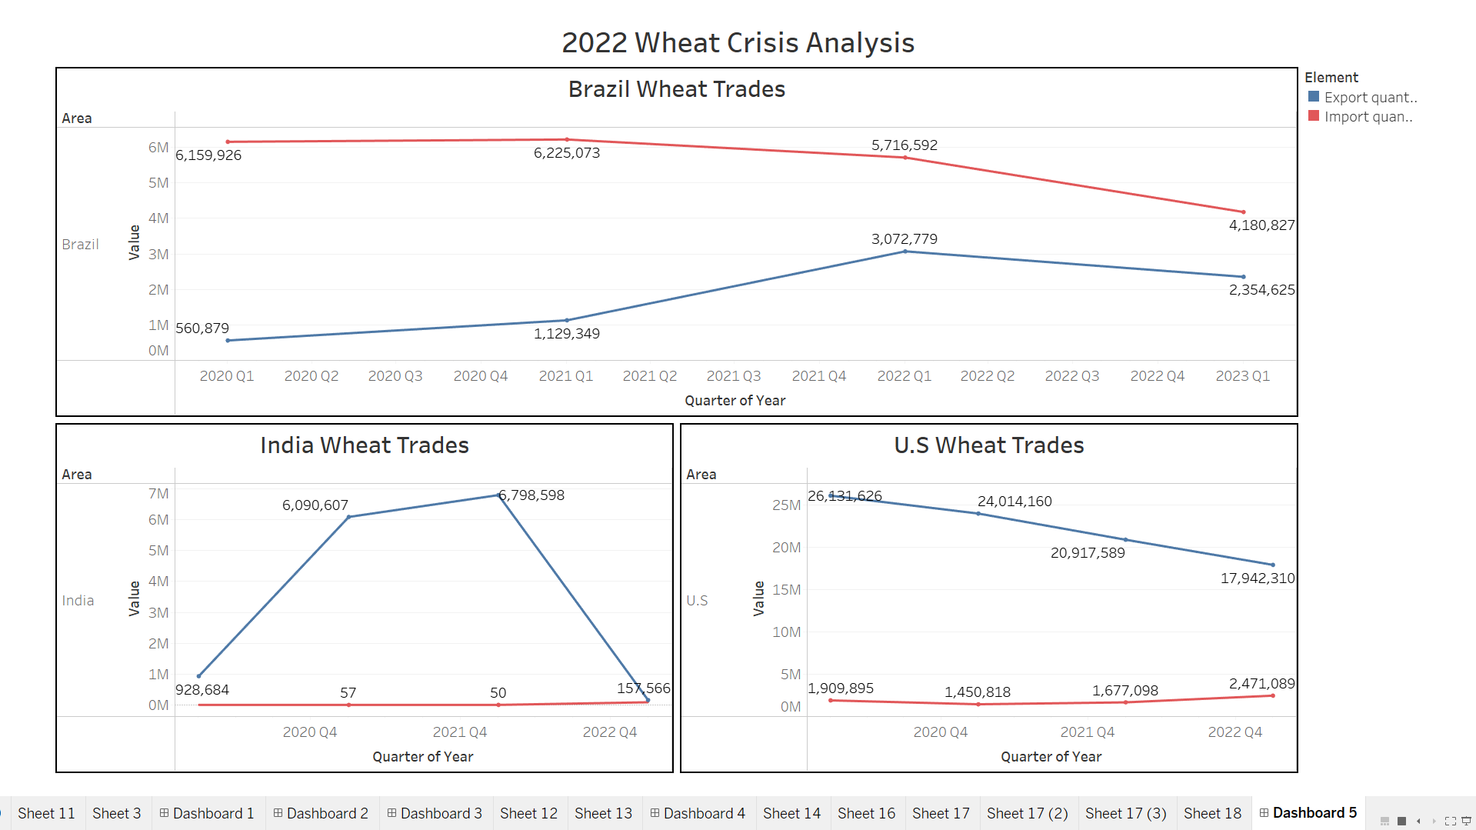
08
Falling Action - New Strategies

Slide 18




Shifts in Global Trade Dynamics
1
The U.S. redirected focus towards maintaining food security domestically while evaluating crop diversification strategies.
2
India ramped up investments in climate-resilient wheat production to better balance food supply needs and international trade demands. (57% stocks up)
3
Brazil actively expanded its production capacity, responding to global price increases to take advantage of high demand.
The global wheat trade landscape became increasingly dispersed, with no single nation retaining control over the market.
4
*Information is taken from news and recent happenings

Slide 19

Conclusion - A New Era of Wheat
09
Category | U.S. | India | Brazil
1990s Role | Dominant exporter | Import-reliant | Passive importer
2020s Role | Climate-stressed exporter | Export-cautious reformer | Emerging regional producer
Strengths | Infrastructure, logistics | Policy, domestic reserves | Innovation, regional trade
Weaknesses | Weather shocks, declining share | Climate vulnerability | Weather shocks, scale
In the dynamic world of wheat, it’s no longer about who was dominant
— it’s about who adapts fastest

Slide 20
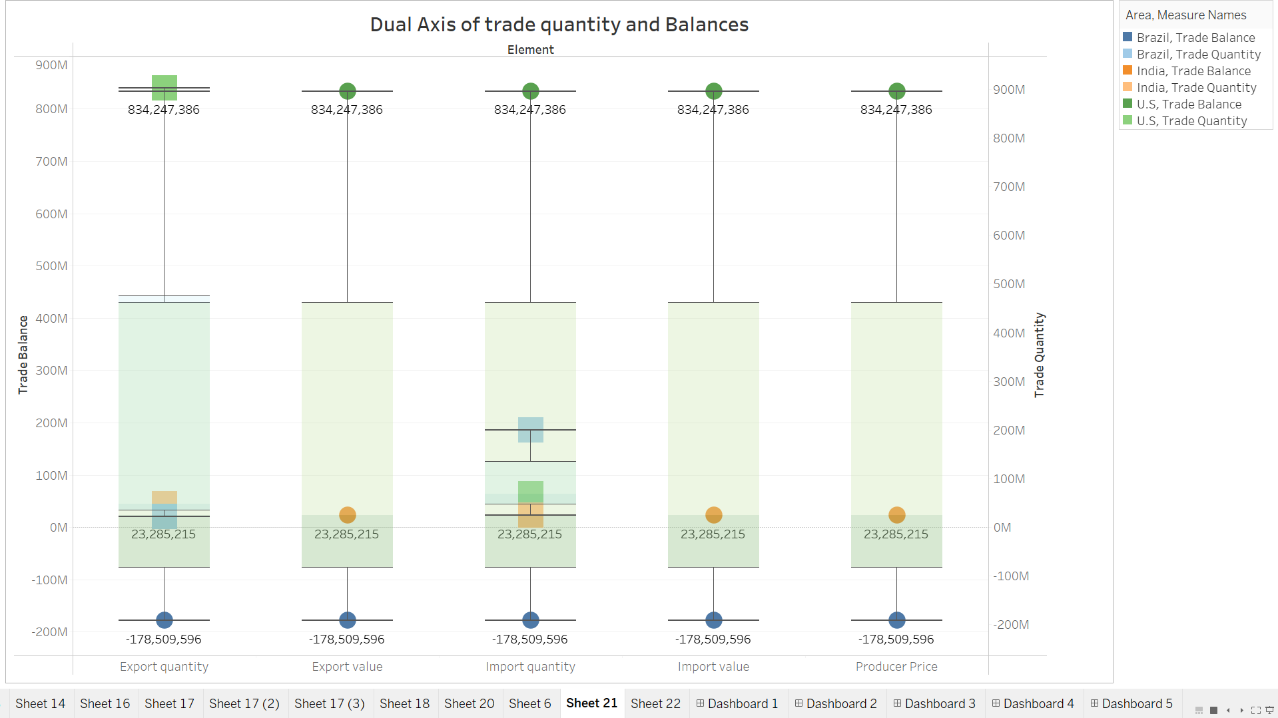
10
Dual Axis Analysis

Slide 21




Key Insights
2
Various factors like climate, political situations, and technological innovations now shape the future of wheat production and distribution.
The control over global wheat trade is no longer monopolized by the U.S. or any individual country.
1
The ongoing struggle for wheat symbolizes a broader narrative about resilience and adaptability in the face of global challenges.
3

Slide 22
Thank You

